Slide 1
Global Issues – Homework Instructions 1
1) Remember: I will give you 13 homework (HW) assignments. You have to do only seven (7). You will not get extra points for doing more than seven HW assignments.
2) Every assignment has five (5) questions and is worth 20 points.
3) You can write your homework by hand or use a computer. If you write by hand, please use black or blue ink or pencil. If you use a computer, please print it using black or dark blue ink. If you use other colors of ink, you’ll get -10%.
4) If you hand in your HW in the classroom,
please use A4 paper only, not B5, A3, B10, etc.
Small papers are too easy for me to lose and write
notes on to help you improve. Larger papers are
too big for me to scan into my computer after I
grade them. If you don’t use A4, you’ll get -10%.
5) You can give me your HW in class every Friday
or by the email due date (usually Friday by 11:59
PM). If you give me late homework, you should also
give me an excuse note (사유서) with it, and there
will be no minus if you give it to me in a timely
manner. Otherwise, it’s -10% for every day (or
part of a day) that it’s late.
This presentation copyright 2021 – Nelson Parish
Homerwork: https://missmonicaesl.blogspot.com/2020/05/actualizacion-de-deberes-semana-25-de.html

Slide 2
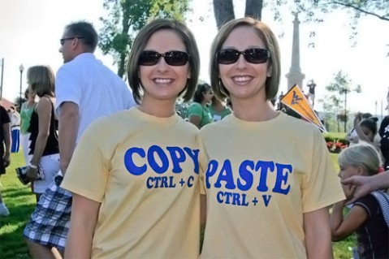
Global Issues – Homework Instructions 2
6) I will grade you on the substance (content) of your answers,
not your English abilities. However, please be careful. If you
write with very poor spelling, grammar, vocabulary, etc., I may
not be able to understand your answer, and you might lose
points.
7) DO NOT:
- …copy from a friend. You will both get “0” for that
question.
- …copy from the Internet, a book, etc. You will get
“0” for that answer even if you copy just one sentence! It is very
easy for me to know if you copy. If you need to copy something
like a graph, picture, or quote, tell me where you got it (e.g., give
the webpage address).
- …copy from the Internet, etc., and then change just a few words. I can still tell when you’ve copied and pasted. For example, don’t do this:
Original sentence from the Internet: “According to the BBC, Tokyo is the biggest city on Earth.”
You change it to: “According to the BBC, Tokyo is the largest city in the world.”
- …use an internet translation program. You will get “0” for that answer.
8) Read Rule #7 again.
9) Lastly, please don’t be careless with your homework. If you are careless and get a bad grade, I won’t give you a chance to do it again. I’m too busy to re-grade carelessly done homework. If you have any questions for me while you’re doing your homework, please ask (in a timely manner)! I’m willing to help!
Questions? Please text me at 010-2867-0341 or email me at anparoikos@gmail.com.
This presentation copyright 2021 – Nelson Parish
Twins: https://photopick.wordpress.com/2009/02/20/copy-and-paste/

Slide 3
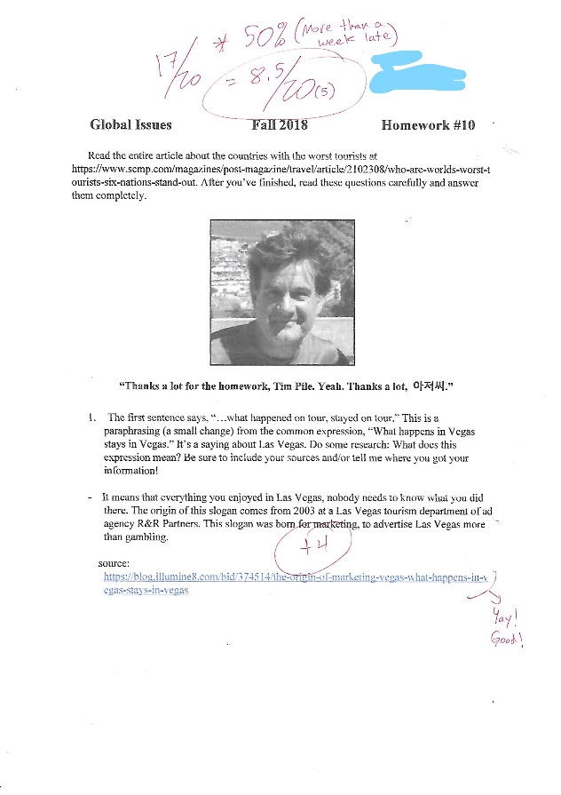
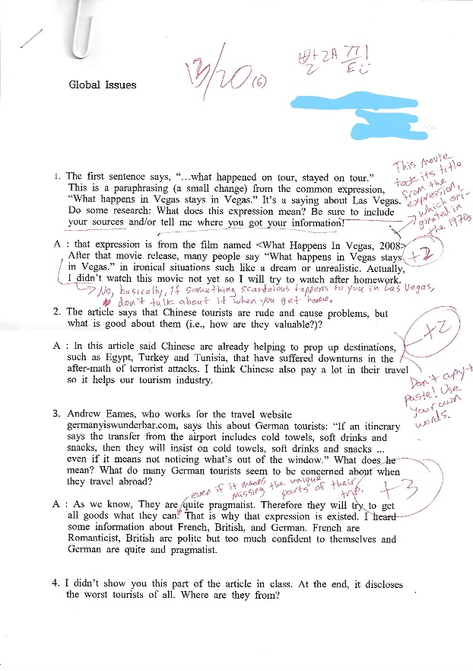
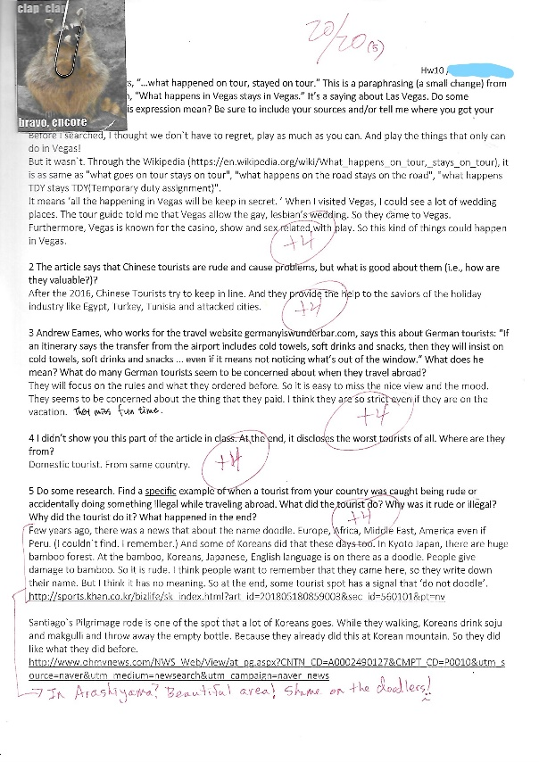
Global Issues – Homework Instructions 3
Here are some examples of papers students wrote.
This student did pretty well (17/20) but turned it in more than a week
late with no excuse! That’s -50%!
Wow! Great job! This student put a lot of care into his/her work. S/He provided sources and answered the questions fully. S/He didn’t even
need more than one piece of paper to complete the assignment well!
Yay!
This student didn’t put much care into his/her work – copying from
the Internet, not answering the
questions fully, etc., so he/she got a low grade.
This presentation and all images on this page copyright 2021 – Nelson Parish

Slide 4
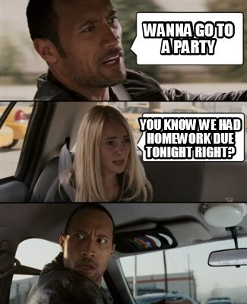
Homework Grading Method
Here is how I’ll grade your homework:
1) If you try to answer the question with at least one complete sentence, even if you get the
answer totally wrong, you get +1 point.
2) If I think you understood the question, you get +1 point.
3) If you answer the question fully (i.e., including sub-questions and giving explanations for
“yes/no” answers), you get +1 point.
4) If you make no factual errors, whether related to the material in the lesson or other
material you get by researching, you get +1 point. This includes using the lesson’s vocabulary
correctly.
This class is taught in English, but it’s not an English class.
Again, I will not be grading you on grammar, spelling, etc. As
long as I can understand your answer, you won’t lose points
for your writing skills.
Again, if you copy even one sentence from the internet or
another source (including another student), you will get 0 for
that question (The other student may also get 0.). You may
copy short quotes, graphics, etc., if you give me the sources,
and these sentences do not make up all or most of your
answer.
If you do any research online, in books, etc., give me your
source(s). You can just copy and paste the webpage URL, for
example. If you don’t do this, you will get 0 for that answer.
This presentation copyright 2021 – Nelson Parish
The Rock: http://www.memecreator.com/meme/wanna-go-to-a-party-you-know-we-had-homework-due-tonight-right/

